Slide 1
ESHWAR PAMULA ANYWARE ROBOTICS TECHNICAL PRESENTATION
Allegion Interconnect Functions and FSAE Anti-Roll Bar Design

Slide 2
My BACKGROUND
FSAE Suspension Engineer for Formula Buckeyes for 2 years.
Helped design, test, and manufacture mounts, uprights, and hardpoints using Mill and Lathe.
Helped design, test, and manufacture uprights and anti roll bar using SolidWorks and CNC Mill.
Secured 3rd Overall at Michigan FSAE (ICE) after 22 years.
R&D Mechanical Engineering Intern at Allegion (Summer 2024)
Worked on the residential NPD locks division.
Undergrad Research:
AI Driven Topology Optimization for Multi-functional Materials and Intelligent Design Laboratory.
Commercial Polymer Gear Testing at Gear & Power Transmission Laboratory.

Slide 3
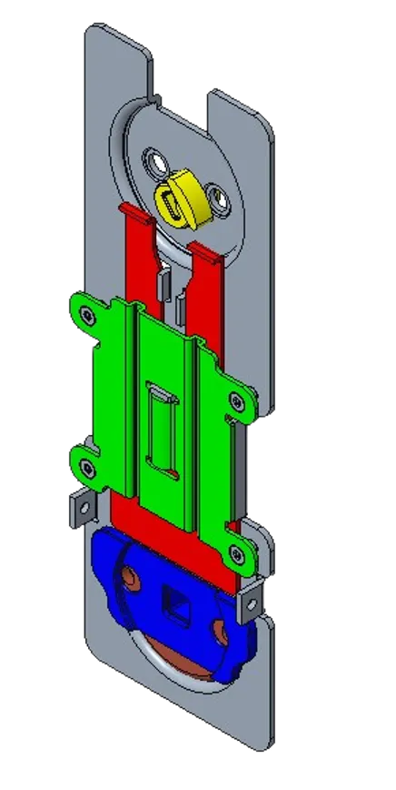
Allegion work
R&D Mechanical Engineering Intern at Allegion (Summer 2024)
Worked on the residential NPD locks division.
Engineering a new Interconnect design with 7 parts and 2 CAMs.
Designed 2 new escutcheons to house all the new and reused components for the locks.

Slide 4
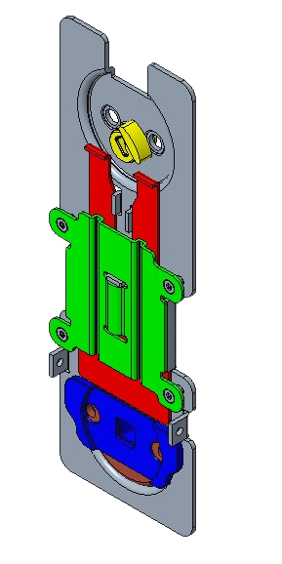
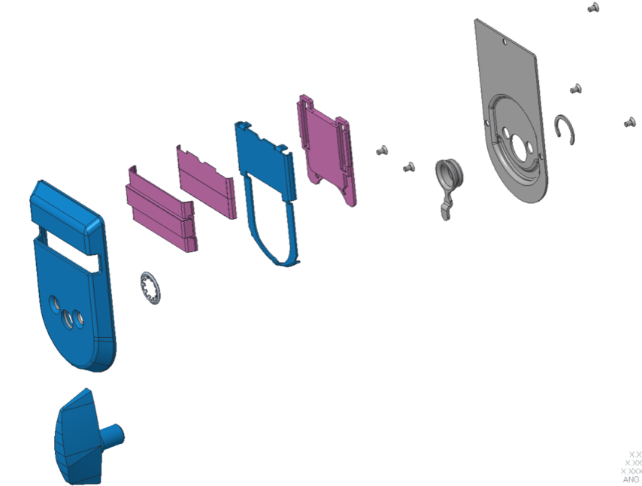
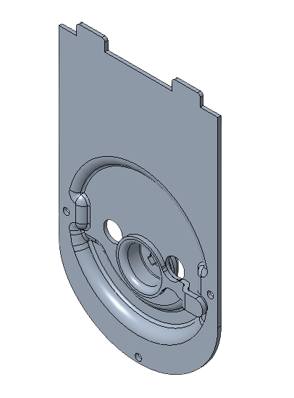
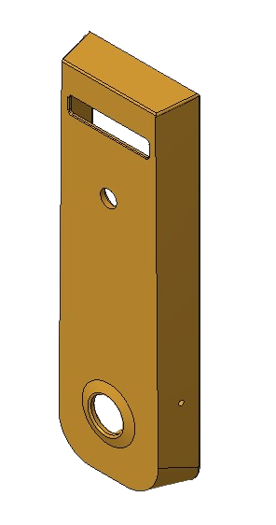
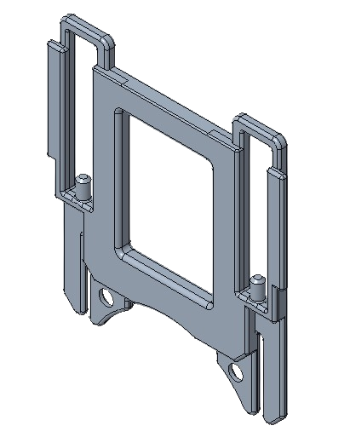
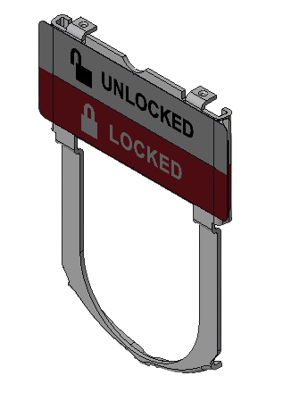
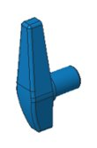
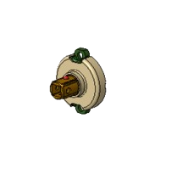
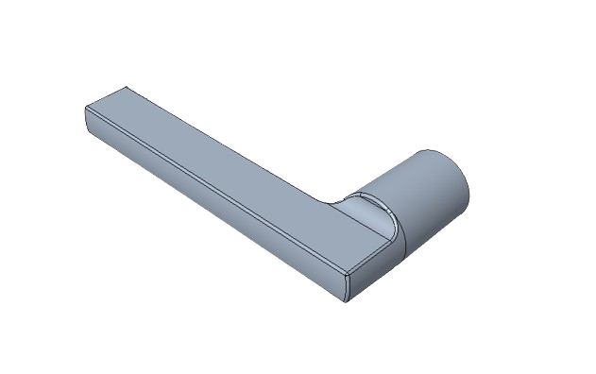
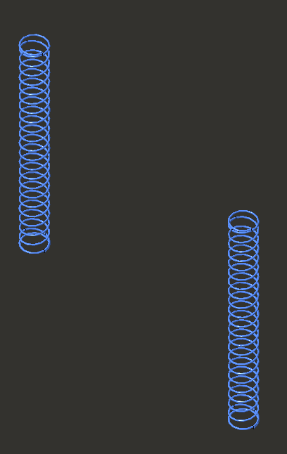
Assembly Process
Screws
Backplate + CAM
Retaining Ring
Series Thumbturn
Spring Housing
IC Slider Assembly
Indicator Assembly
Apollo Spring Cage
Springs
FI+ Lever
Escutcheon

Slide 5
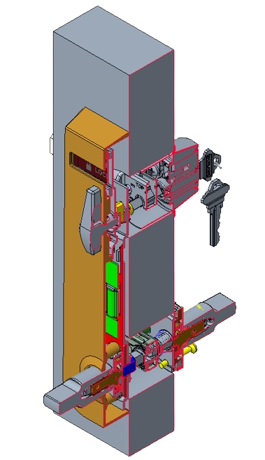
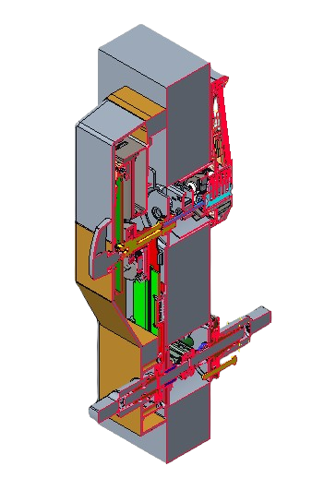
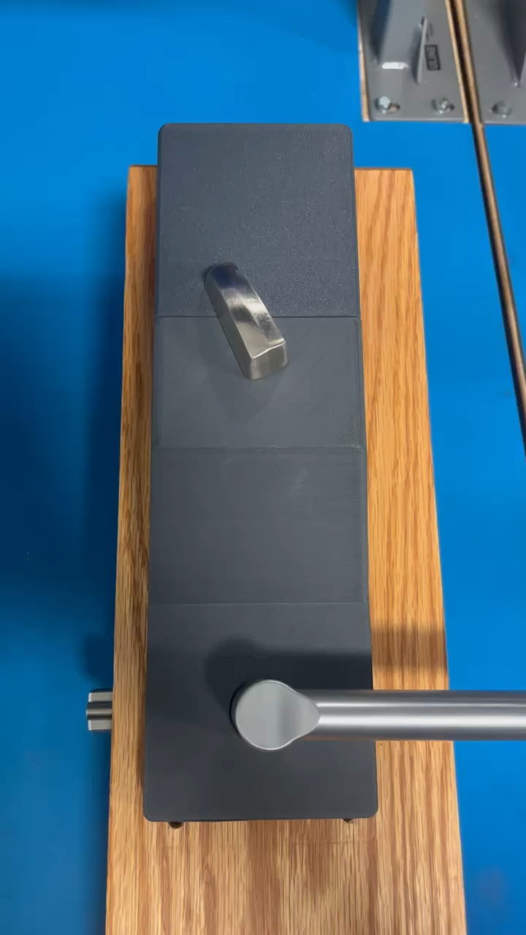
Section view & WORKING
Indicator Lock with Interconnect and the Electronic Lock with Interconnect.

Slide 6
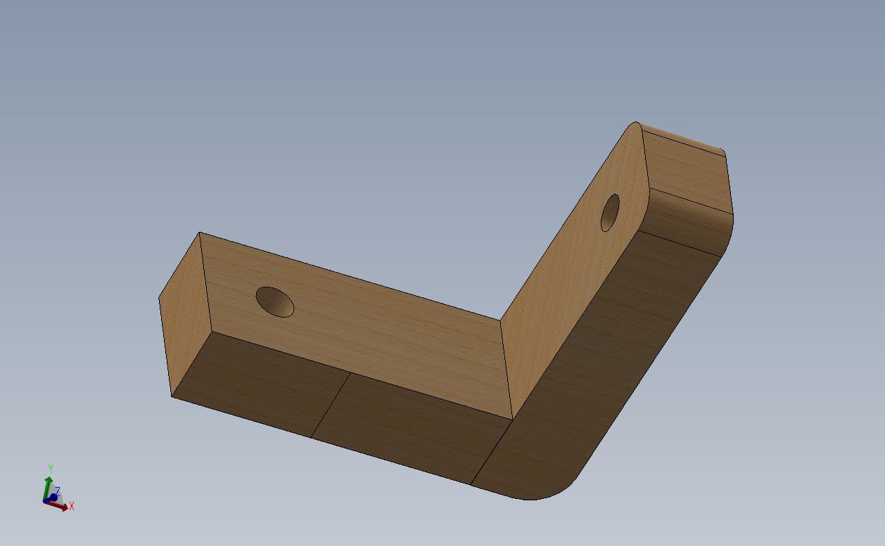
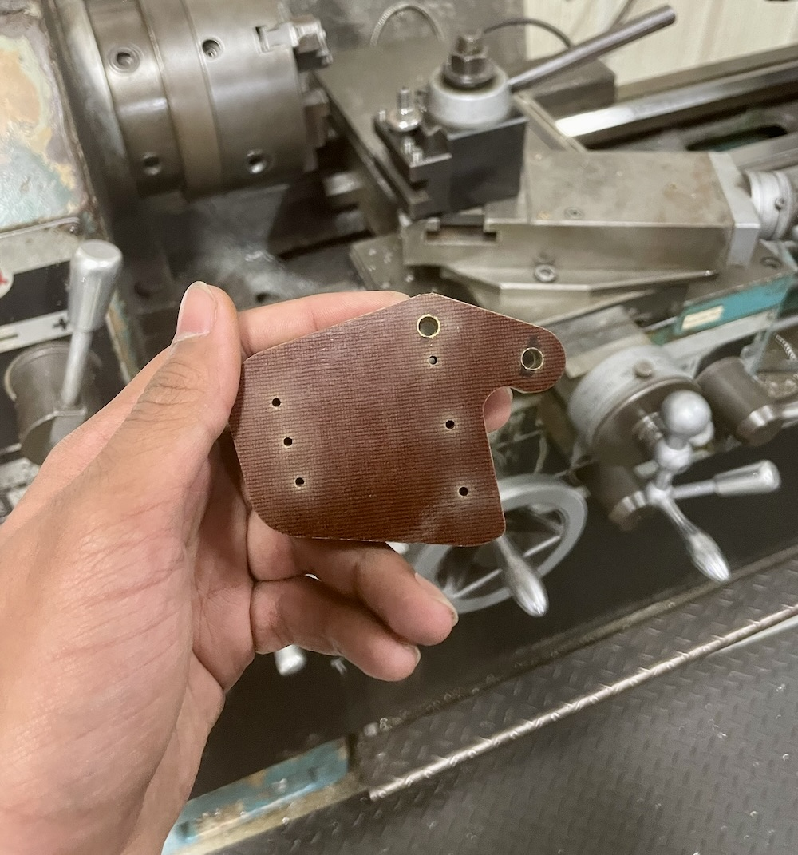
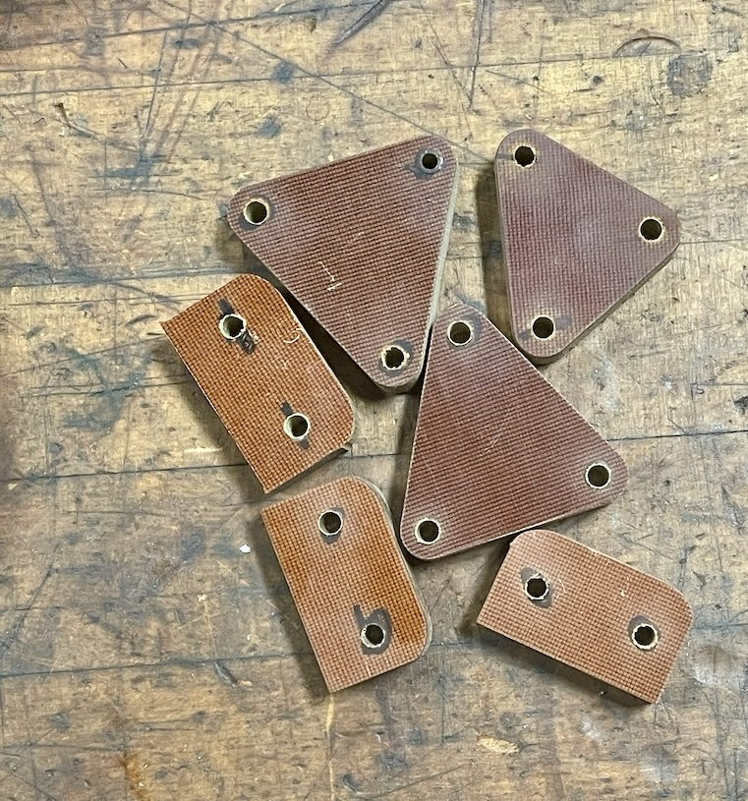
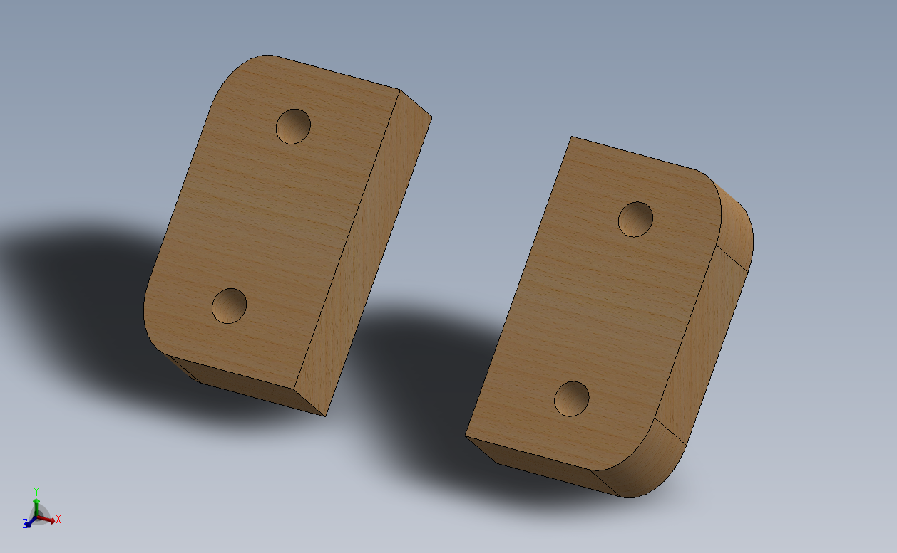
FORMULA BUCKEYES FSAE
Some of the hard points (Birch Plywood) I designed and manufactured using Waterjet, Sander, and the Mill

Slide 7
FORMULA BUCKEYES: Anti-Roll Bar
Goals:
Adjust the oversteer/understeer characteristics of the vehicle.
Want a wide enough adjustment range to achieve either at any time according to driver preference.
Keep weight to a minimum.
Design Scope:
Design anti roll bars (ARBs) around existing pushrod – rocker suspension setup.
Continue with 4 corner spring setup.
Roll center location and CG height changes not considered.
Overall chassis shape was treated as fixed.
Previous Stiffness Target was defined as 200 Nm/deg and the old bar did not meet this target. Did not know if this was accurate, the team decided to start from scratch.

Slide 8
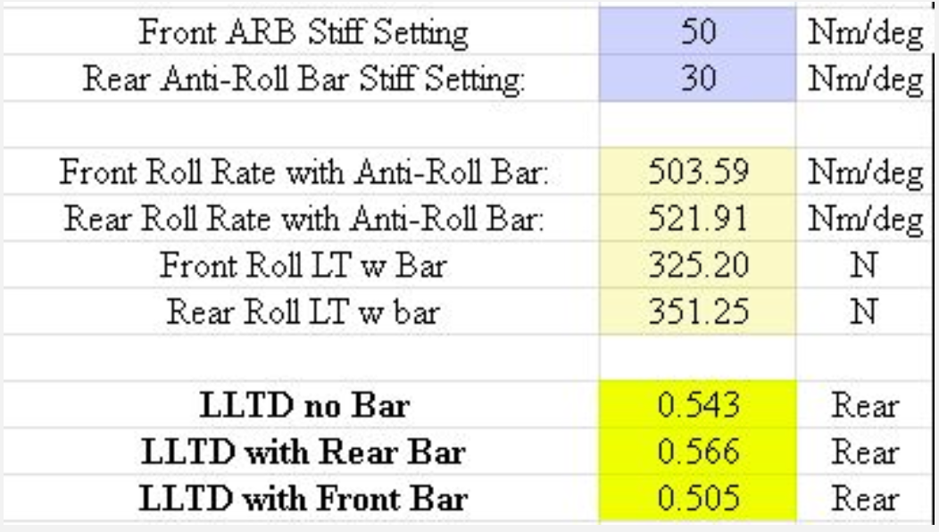
AR Bar: Setting specific targets
Tire is sensitive to load.
Lower COF at higher normal load.
ARBs function by changing the Lateral Load Transfer Distribution (LLTD)
Stiffer front roll rate = more load transfer on the front axle = more understeer.
Want the LLTD to be centered around CG location and have adjustment to be well in front or behind the CG.
4. Changing roll stiffness of one axle relative to the other changes LLTD.
Stiffer front roll stiffness = more understeer.
CG location ~ 0.525 (52.5% rear)
Overall Load Transfer Equation: $ΔW=\frac{W⋅A_{y}⋅H_{cg}}{TrackWidth}$
Roll Moment Load Transfer Equation: $ΔW=Total LT⋅\frac{K_{θF}+\left(\left(l−x\right)⋅W⋅\frac{h}{l}\right)}{K_{θF}+K_{θR}−W⋅h}$

Slide 9
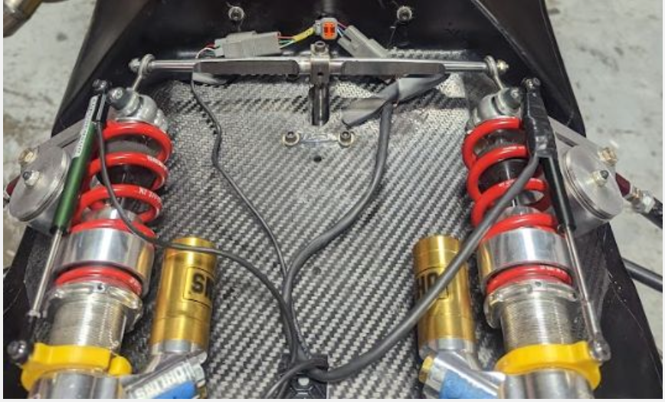
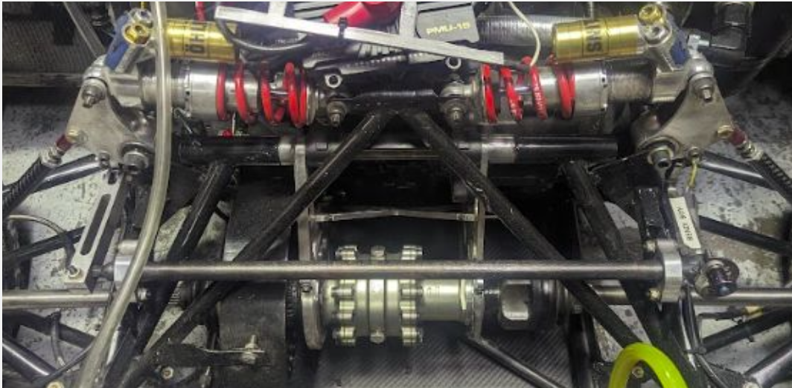
AR BAR: HITTING TARGETS
Left: T-Bar Setup in the front to achieve longer moment arm to twist section.
Right: Traditional twist bar setup in the rear.
Packaging constraints led to different solutions for the front and rear bars in order to hit stiffness targets and keep and acceptable F.O.S.

Slide 10
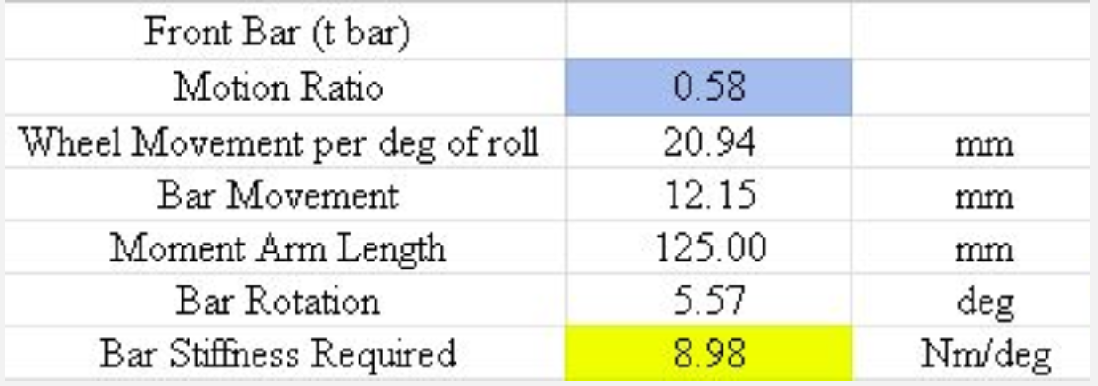
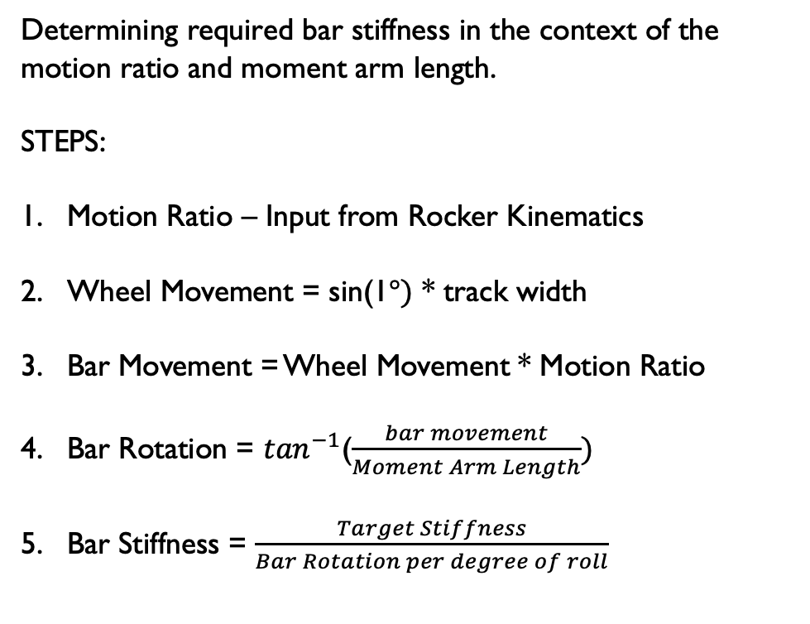
AR Bar: HITTING THOSE targets
Determining required bar stiffness in the context of the motion ratio and moment arm length.
STEPS:
Motion Ratio – Input from Rocker Kinematics
Wheel Movement = sin(1$°)$ * track width
Bar Movement = Wheel Movement * Motion Ratio
Bar Rotation = $\tan^{−1}$($\frac{bar movement}{Moment Arm Length})$
Bar Stiffness = $\frac{Target Stiffness}{Bar Rotation per degree of roll}$

Slide 11
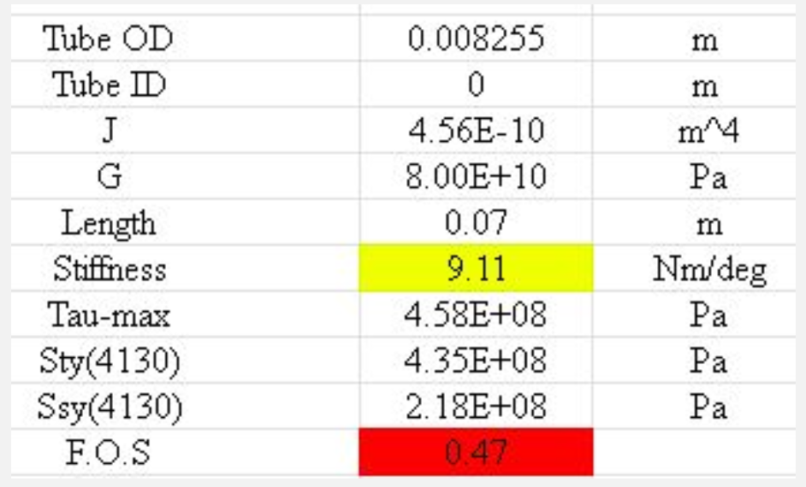
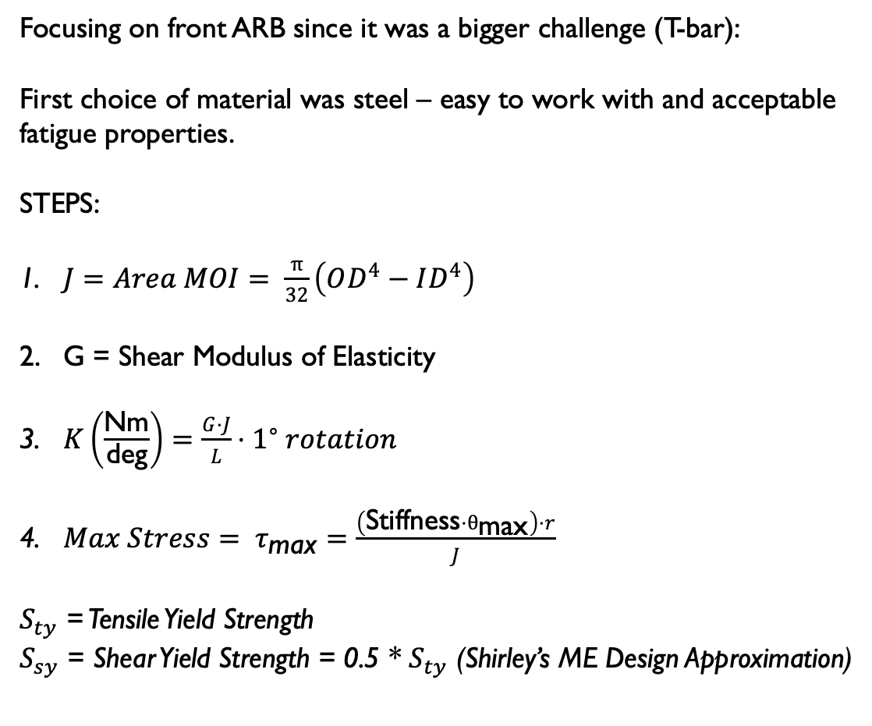
AR Bar: HITTING THOSE targets
Focusing on front ARB since it was a bigger challenge (T-bar):
First choice of material was steel – easy to work with and acceptable fatigue properties.
STEPS:
$J=Area MOI= \frac{π}{32}\left(OD^{4}−ID^{4}\right)$
G = Shear Modulus of Elasticity
$K\left(\frac{\text{Nm}}{\text{deg}}\right)=\frac{G⋅J}{L}⋅1^{∘} rotation$
${Max Stress= τ}_{\text{max}}=\frac{\left(\text{Stiffness}⋅θ_{\text{max}}\right)⋅r}{J}$
$S_{ty}$ = Tensile Yield Strength
$S_{sy}$ = Shear Yield Strength = 0.5 * $S_{ty}$ (Shirley’s ME Design Approximation)
FOS – Not Acceptable

Slide 12
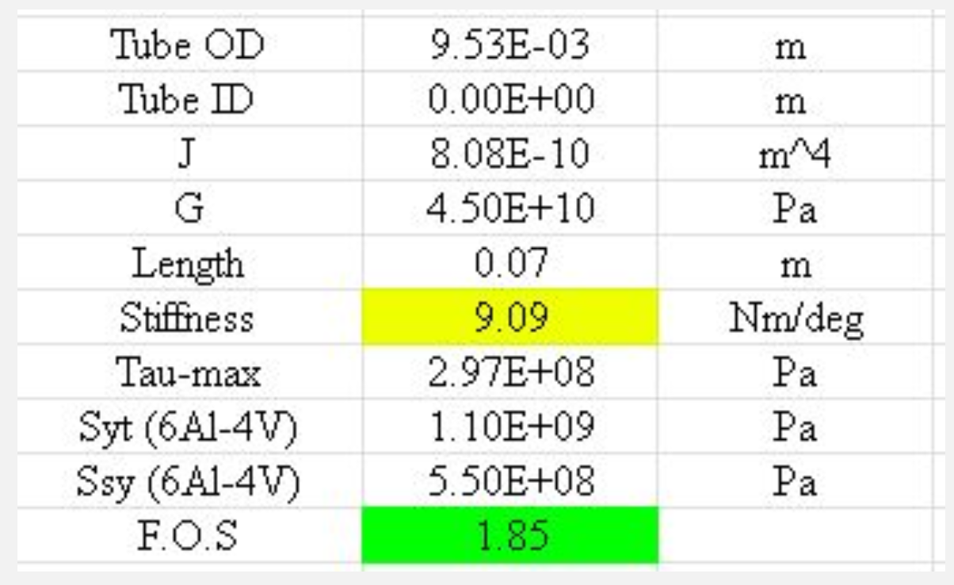
AR Bar: HITTING THOSE targets
Focusing on front ARB since it was a bigger challenge (T-bar):
Titanium has lower shear modulus (less stiff) but higher shear yield strength.
Thicker bar compared to steel to meet targets.
Lower F.O.S than we would typically accept but ARB is not a critical component in terms of damages to the car in the event of failure.)

Slide 13
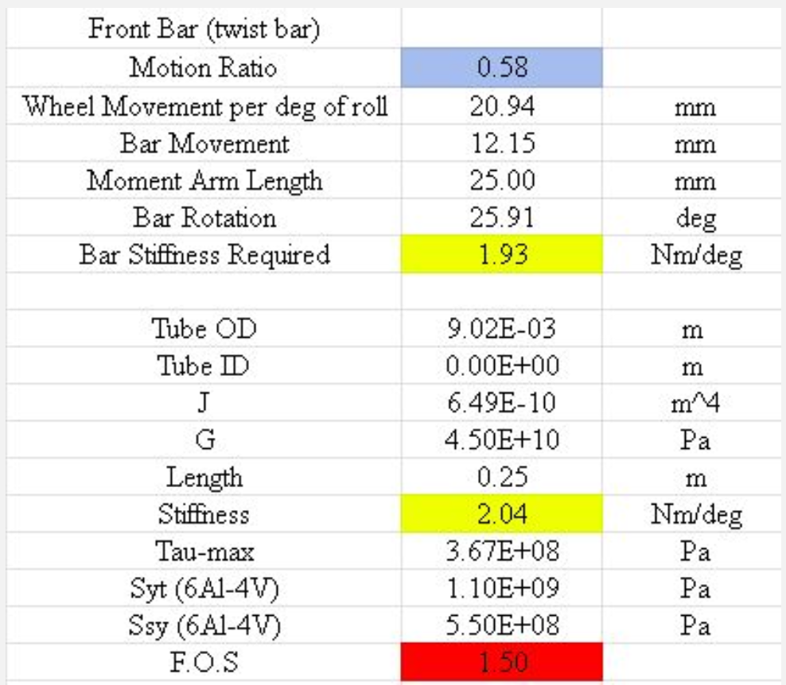
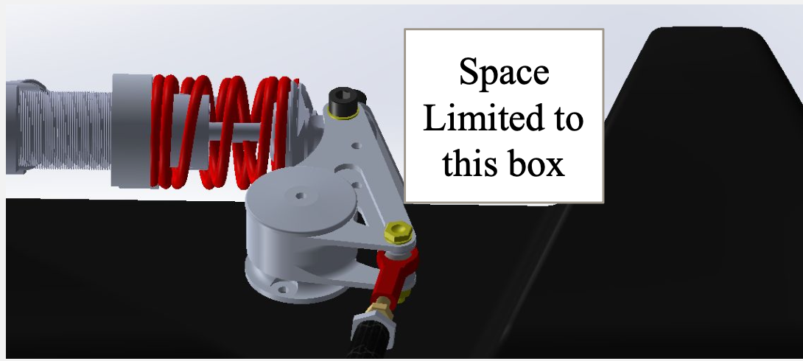
AR Bar: HITTING THOSE targets
Using a traditional twist bar set up in the from leads to a small moment arm.
This increases the deflection of the twist bar, lower F.O.S.
Allows for longer length of twist bar, however this is overpowered by the reduction in moment arm length.
Wanted to keep height below the top of the chassis.

Slide 14
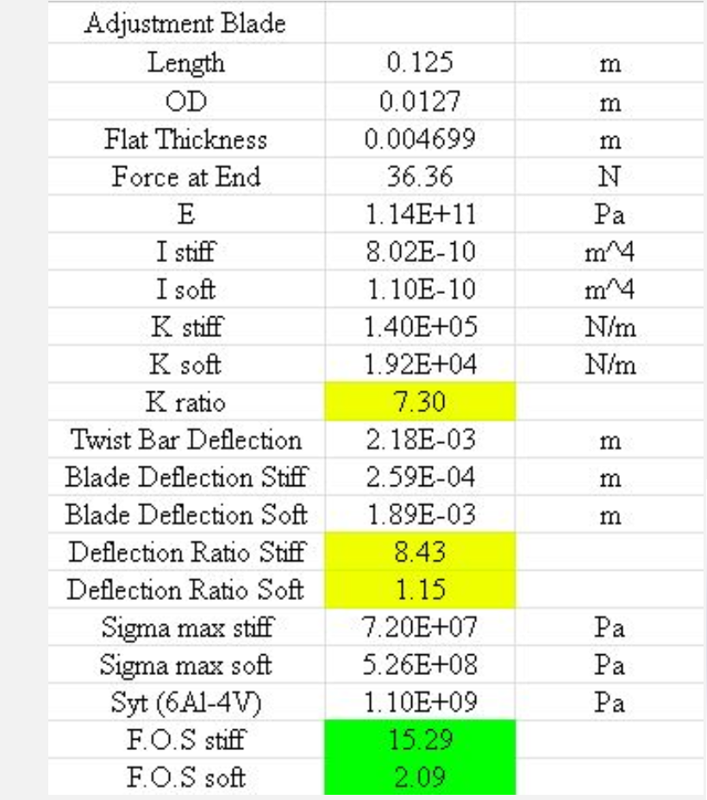
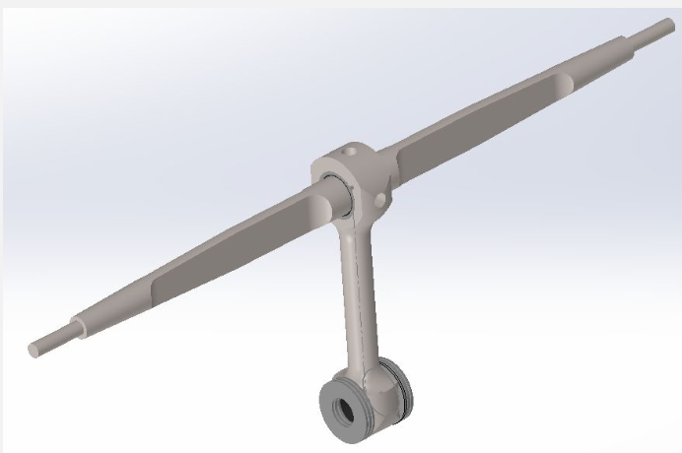
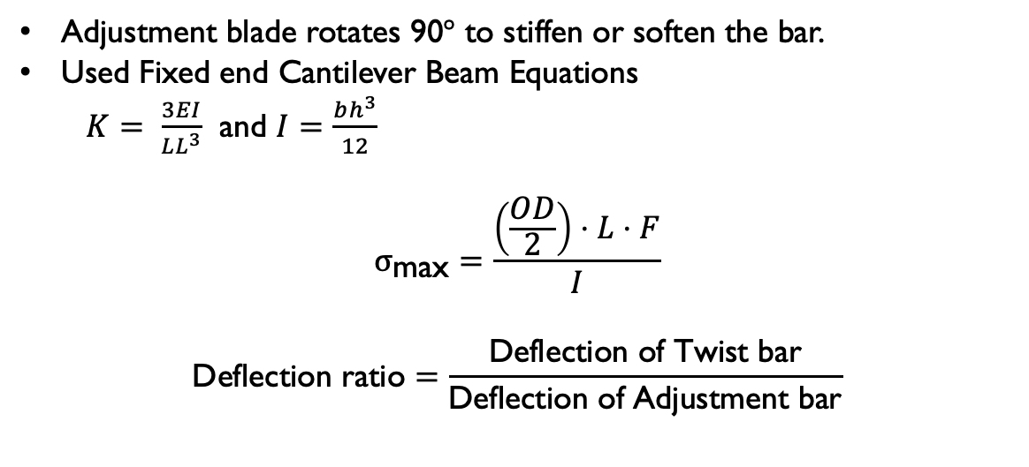
AR Bar: HITTING THOSE targets
Adjustment blade rotates 90$°$ to stiffen or soften the bar.
Used Fixed end Cantilever Beam Equations
$K= \frac{3EI}{LL^{3}}$ and $I=\frac{bh^{3}}{12}$
$$σ_{\text{max}}=\frac{\left(\frac{OD}{2}\right)⋅L⋅F}{I}$$
$$\text{Deflection} \text{ratio}=\frac{\text{Deflection} \text{of} \text{Twist} \text{bar}}{\text{Deflection} \text{of} \text{Adjustment} \text{bar}}$$

Slide 15
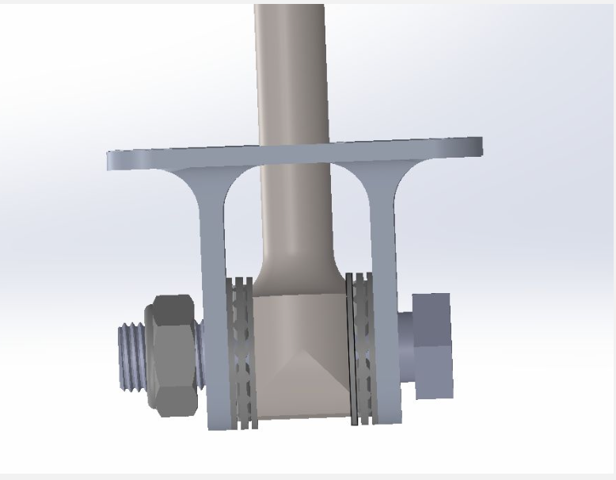
AR Bar: Chassis INTEGRATION
If chassis torsional stiffness is not high enough to transmit load between axles, ARBs will be ineffective.
Set 70% effectiveness as the goal for chassis stiffness.
Front roll stiffness, chassis stiffness, and rear roll stiffness are 3 springs in series.
Applied a torque to the front suspension and found roll distribution for varied chassis stiffness.
Target was set at 1350 Nm/deg.
Bolts are in shear, decided on 4 bolts on the mount to spread out the load.
Cylindrical hardpoints in the chassis layup for each bolt.
Provided maximum torque from bar on the chassis.

Slide 16
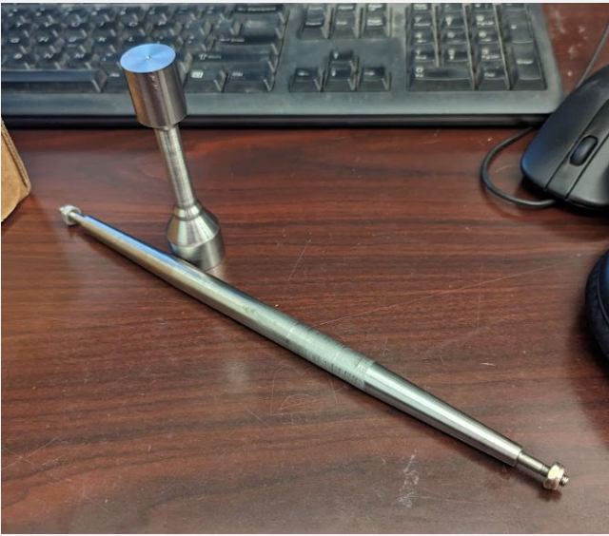
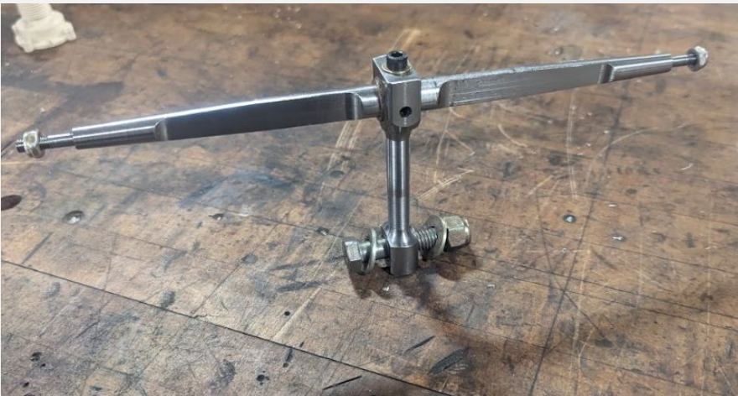
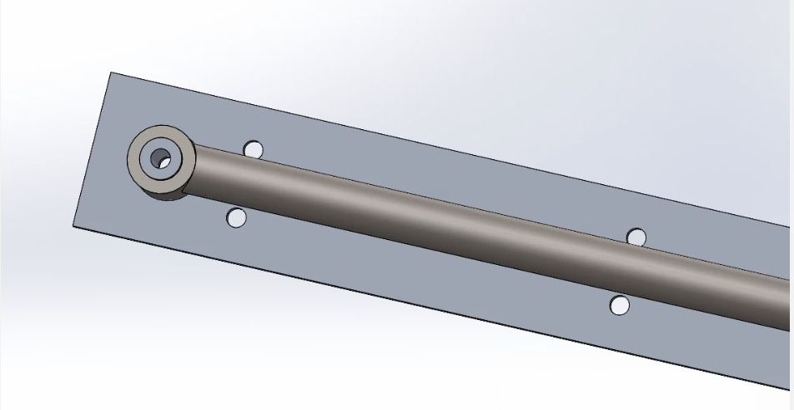
AR Bar: manufacturing
This was my first time working with CNC lathe, so I mostly shadowed the Suspension Lead to learn how to use the machine for making these parts.
For the Rear ARB which was welded, I worked on designing and water jetting the locating plate.

Slide 17
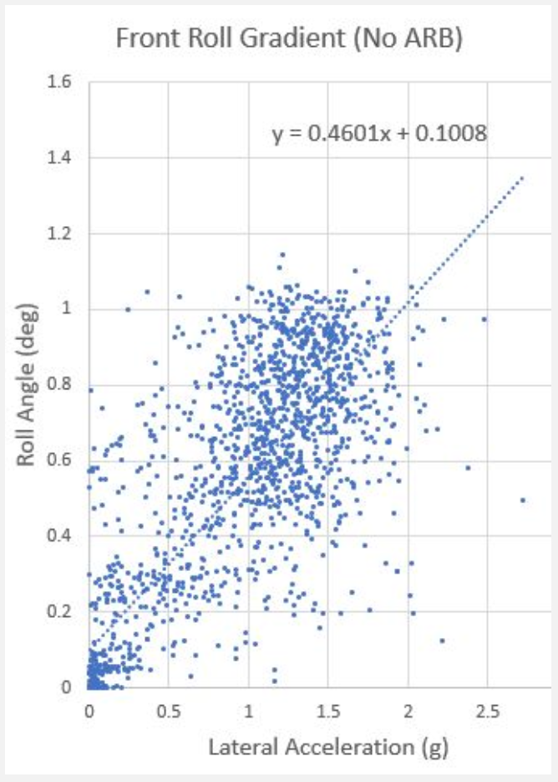
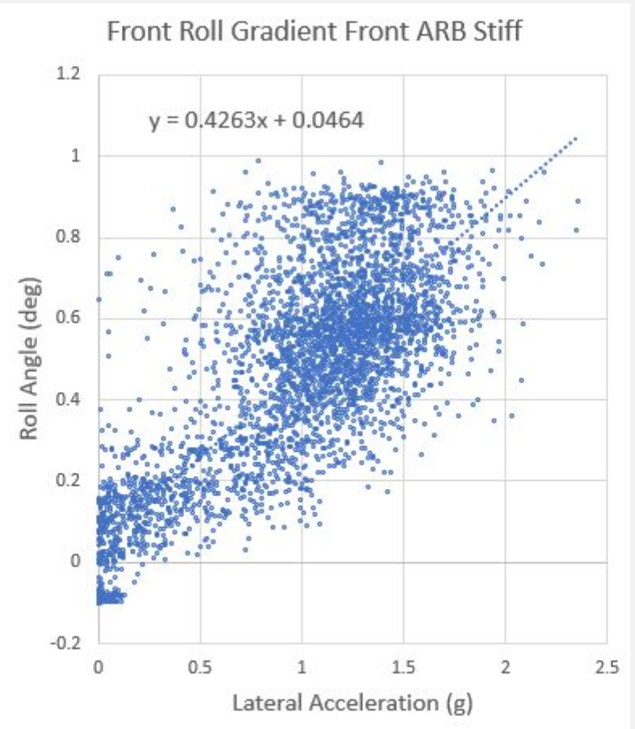
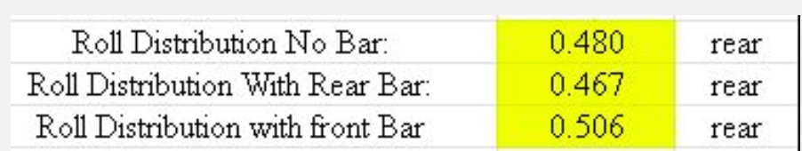
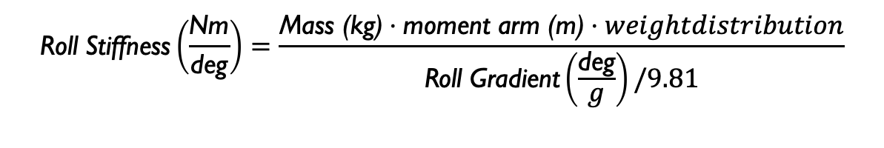
AR Bar: TESTING
Changes in roll distribution for different ARB positions show that the roll stiffnesses are changing.
Measured with linear potentiometers on each spring and damper unit.
Theoretical Values:
Roll Gradient used to find total Roll Stiffness for various ARB settings.
Theoretical No ARB (excluding tire) = 702
Measured: 738
Theoretical with front ARB = 752
Measured = 796.85
$$\text{Roll} \text{Stiffness}\left(\frac{\text{Nm}}{\text{deg}}\right)=\frac{\text{Mass}\text{ (}\text{kg}\text{)}⋅\text{moment} \text{arm}\text{ (}\text{m}\text{)}⋅weightdistribution}{\text{Roll} \text{Gradient}\left(\frac{\text{deg}}{g}\right)/9.81}$$

